Slide 1
Happy Mother’s Day!
2024: Living a Life of Grace
Today’s Scripture:
| Exodus, Ephesians, 1 Samuel, Proverbs, 2 Timothy |
( Selected Verses )
~ Amplified Bible ~

Slide 2
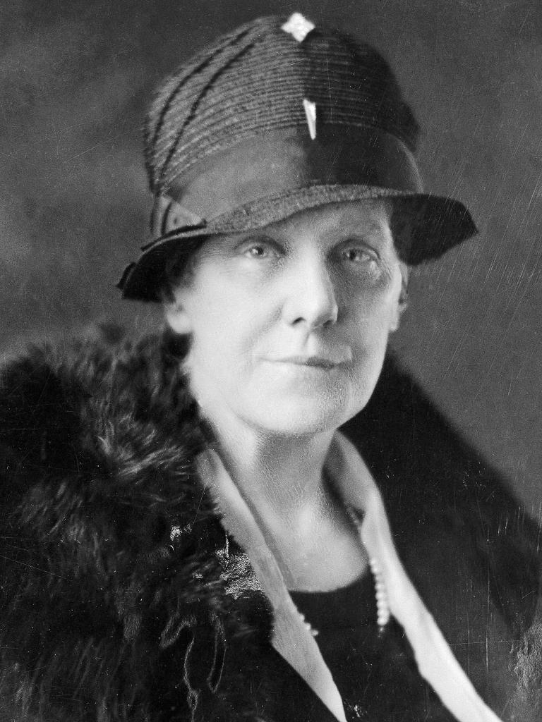

Slide 3
Anna Jarvis wanted to honor her mother by continuing the work she started and to set aside a day to honor all mothers because she believed that they were "the person who has done more for you than anyone in the world.”
1905 Her Mother Died
1911 Mother’s Day in all 48 states
1914 Presidential Proclamation

Slide 4
Exodus 20:12
¹² “Honor (respect, obey, care for) your father and your mother, so that your days may be prolonged in the land the Lord your God gives you.
Ephesians 6:2-3
² Honor [esteem, value as precious] your father and your mother [and be respectful to them]—this is the first commandment with a promise— ³ so that it may be well with you, and that you may have a long life on the earth.

Slide 5
1 Samuel 16:7 Amplified Bible (AMP)
⁷ But the Lord said to Samuel, “Do not look at his appearance or at the height of his stature, because I have rejected him. For the Lord sees not as man sees; for man looks at the outward appearance, but the Lord looks at the heart.”

Slide 6
³⁰ Charm and grace are deceptive, and [superficial] beauty is vain,
But a woman who fears the Lord [reverently worshiping, obeying, serving, and trusting Him with awe-filled respect], she shall be praised.

Slide 7
¹⁰ An excellent woman [one who is spiritual, capable, intelligent, and virtuous], who is he who can find her? Her value is more precious than jewels and her worth is far above rubies or pearls.

Slide 8
2 Timothy 1:5
⁵ I remember your sincere and unqualified faith [the surrendering of your entire self to God in Christ with confident trust in His power, wisdom and goodness, a faith] which first lived in [the heart of] your grandmother Lois and your mother Eunice, and I am confident that it is in you as well.

Slide 9
2 Timothy 1:6
⁶ That is why I remind you to fan into flame the gracious gift of God, [that inner fire—the special endowment] which is in you through the laying on of my hands [with those of the elders at your ordination].

